Slide 1
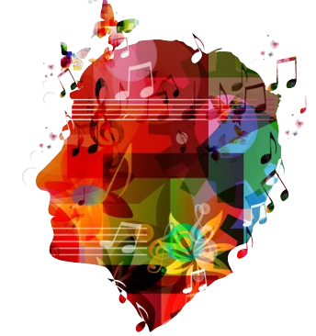
Effects of Music on Mental Health Exploratory Data Analysis
By Sarah Chauvin, Elizabeth Viramontes, and Gabriela Zarate
Notes:
*** Gabriela
Good evening everyone, my name is Gabriela and I’m here with Sarah and Elizabeth we will be talking about our data analysis of the Effects of Music on Mental Health.

Slide 2
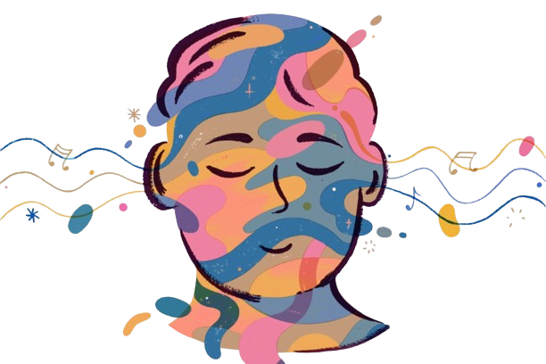
Introduction
Mental health is a very prevalent issue in today’s society.
We all listen to music constantly. How does it actually affect us?
Data from a computer science student researching music therapy in 2022
Over 700 respondents
Mostly online, some physical surveys
Included 16 music genres and 4 mental health disorders
Less common genre definitions
EDM: electronic dance music
R&B: rhythm and blues, subset of jazz
K pop: Korean popular music
Gospel: religious music
Lofi: low fidelity, or imperfect sound, mix of hip hop, jazz, and soul
Notes:
*** Gabriela
Since the beginning of this project, we have known we wanted to analyze data related to mental health. We think this issue is important and impacts our daily lives, and we all enjoy listening to music.
For an overview of our project, most of the survey results were obtained online.
We managed over 700 responses, and the data included 16 music genres and 4 mental health disorders.
As you can see on the screen, we Include a quick shorthand with some vocabulary in case you guys are not familiar with that. Look to this list really quick.

Slide 3
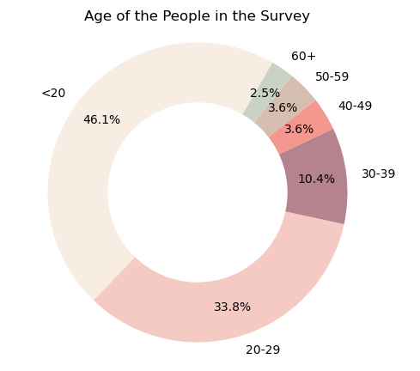
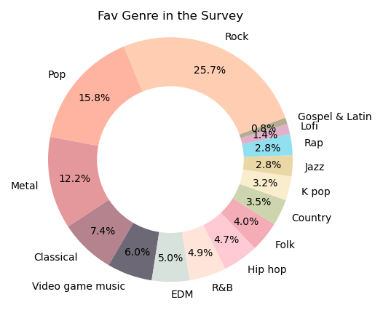
Mental health disorders included in survey: Anxiety, Depression, Insomnia, & Obsessive-Compulsive Disorder (OCD)
Notes:
*** Elizabeth
- This survey was based on four mental health disorders: Anxiety, Depression, Insomnia and Obsessive-Compulsive Disorder or in short words OCD.
To have an idea how the data is moving around the four mental health disorders:
In the donut chart you can see the percentage for different group ages for the people in the survey.
The age of less than 10 wasn’t included because the survey doesn’t apply to people at these ages.
The other donut chart is reflecting the percentage of favorite type of music according to the respondents’ vote.s.

Slide 4
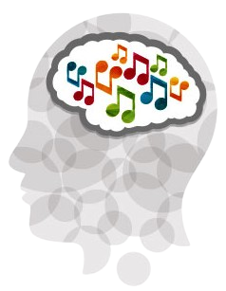
Data Cleaning
Info we did not use:
Primary streaming service
Whether or not the user listened while working
Instrumentalist vs Composer
If user spoke multiple languages
Dropped unreliable data rows
“999999999.0” BPM
Listened 24 hours/day
Null values for Music Effects (Improved or Worsened MH)
Null values for Age
Replaced string values in Frequency columns with integers for objective comparison
Notes:
*** Sarah
Our initial data cleaning was pretty straightforward.
The dataset included some information we did not use, such as the respondents’ primary streaming service and if they spoke multiple languages. There wasn’t enough information in the survey to make these sections relevant.
We dropped several responses where we deemed the info not reliable, such as the user who listed his average BPM as almost 1 billion beats per minute, as well as those who said they listen to music 24 hours/day.
We also replaced the string responses in the Frequency columns for each genre with integers for objective comparison. More on that later.

Slide 5
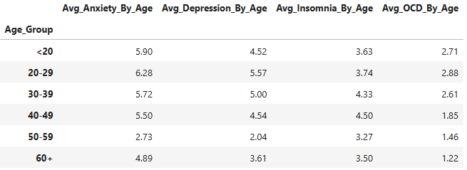
Are there significant differences in mental health rankings based on age groups for those who frequently listen to specific genres?
Distribution of illness by age
What is the average of levels of mental problems based on age groups? where 0 is nothing and 10 is extreme.
Notes:
*** Elizabeth
- One of the questions to review in this project is Are their significant differences in mental health rankings based on the age groups for those who frequently listened to specific genres?
- To understand this question and the ones following, we need to understand the distribution of illness by age.
- This leaderboard shows the averages according to the group ages but we can visualize this better on the next slide.

Slide 6
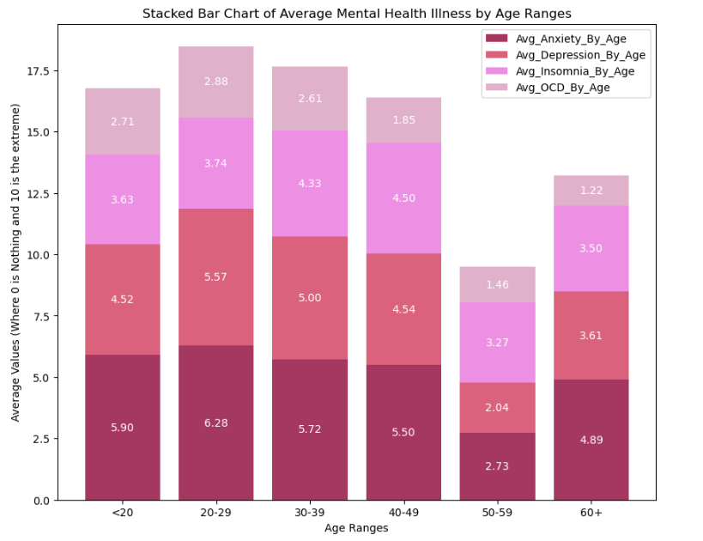
- The highest rates of mental problems are found before the age of 40.
- After the age of 30, levels of MH disorders decrease.
- According to formal studies on OCD from 1980, this disorder mostly occurs between 14 and 35 years of age.
Notes:
*** Elizabeth
The bar chart has indicators for the average mental illness by age range.
The highest numbers for mental problems are before the age of 40.
The reasons could be all the changes happening during that time of the life, like work, school, economic issues, etc.
At over 30 years, these numbers start decreasing. The biggest drop is after the 50, which could be because the people’s lives are more stable.
After the age of 60 we can see again another increase, as with retirement, expenses increase as health issues appear.
For OCD, we don’t see a big difference in the numbers since this mental issue has been studied since the year 1980, and according to the results, this issue is been present diagnosed in people between 14 and 35 years old. You can see on the graph that this is true.

Slide 7
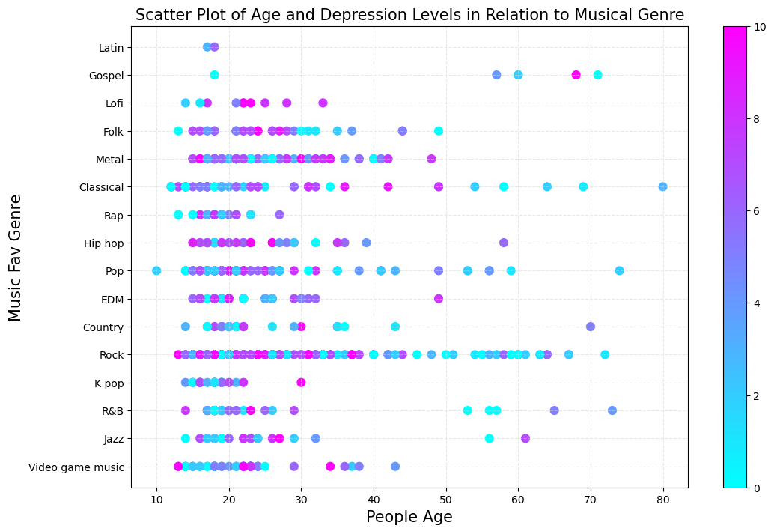
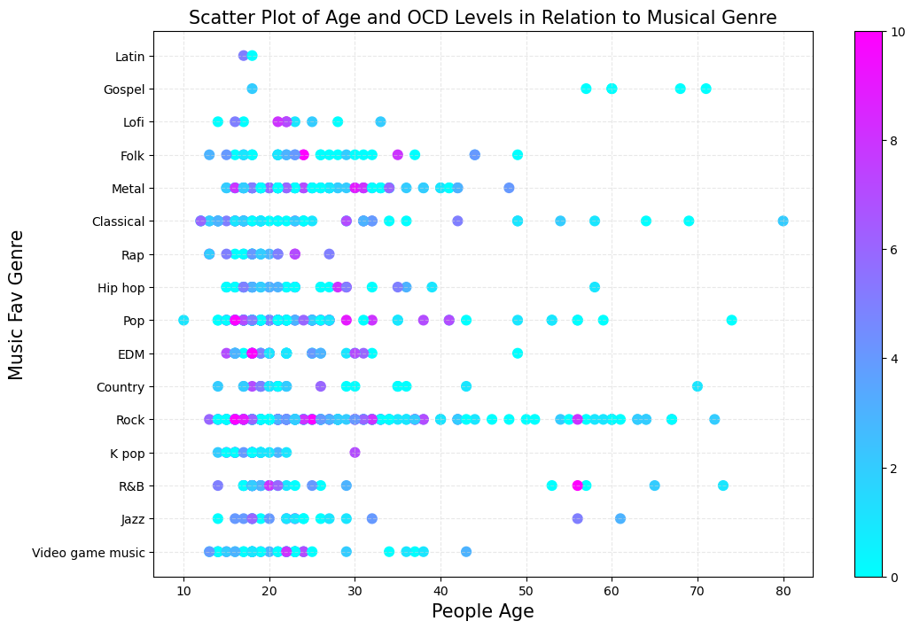
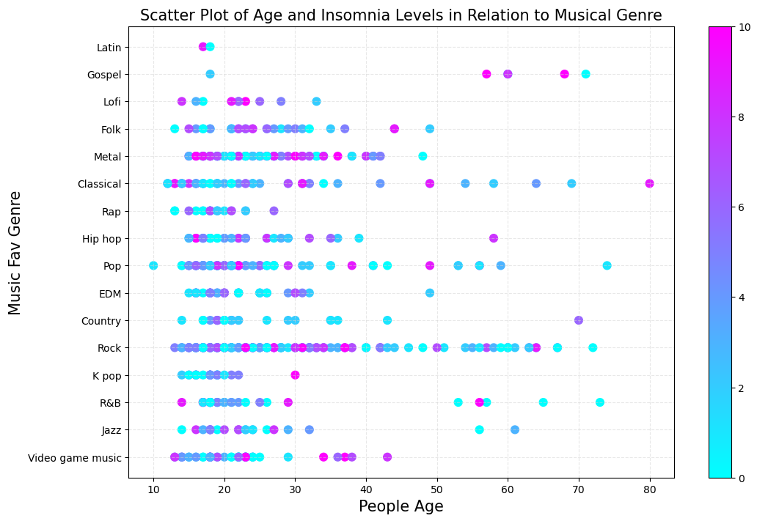
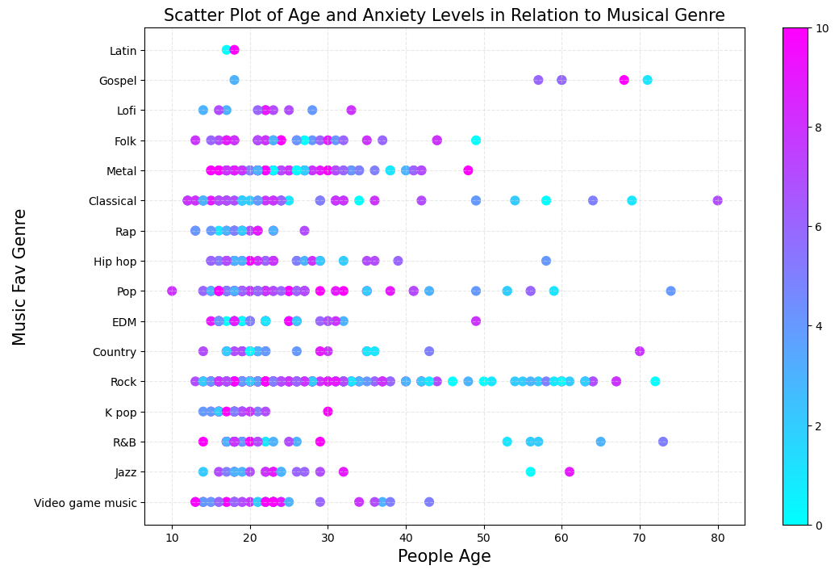
Illness level by Fav Genre and Age
-Increase Anxiety, Depression and Insomnia on Ages <30 with Pop, Rock and Video Game Music.
-Increase OCD, with Pop, Rock. Some outliers.
Notes:
*** Elizabeth
- Now that we reviewed the mental health problems and how they present according to ages,
we can understand the scatter plot that reflects the relationship between the ages and illness with favorite types of music.
Mental health rank can be seen in the color bar. Blue represents a really low rank of illness as the color gets pinker, the illness is worse.
With Anxiety, the pink colors are easy to observe on Pop, Rock and Video Game Music, Depression and Insomnia are similar.
For these three illnesses, the rank is higher n the ages under the 30s, but for the people over than 40, we have lower illness ranks.
This could be also because as we see at the start of the presentation the survey was completed by more people with ages close to the 20s.
For OCD, the numbers stay pretty low, which indicates that music doesn’t have much effect on this problem.

Slide 8
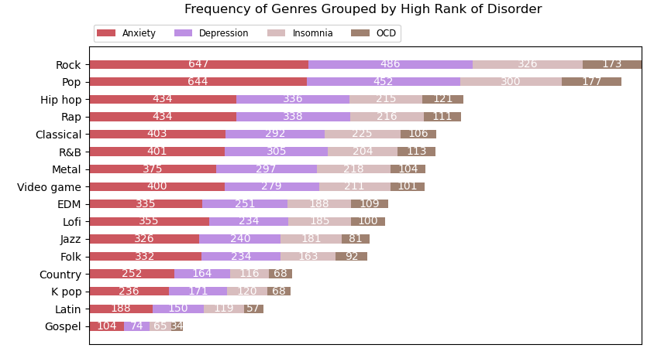
Does the frequency of listening to different genres correlate with different mental health disorders?
Notes:
*** Sarah
- Now that we’ve broken down our data by age group and disorder, we wanted to see if there was a correlation between users claiming a high rank of each disorder and the genres they listened to.
For this analysis, I only looked at data where the user claimed a 7 or higher in MH disorder ranking.
Since we changed the Frequency responses to integers, I looked at the sums of those numbers to create this aggregate overall view of popularity of each genre.
You can see that listeners of Rock and Pop have the highest rank of mental illness for all 4 disorders in this study.

Slide 9
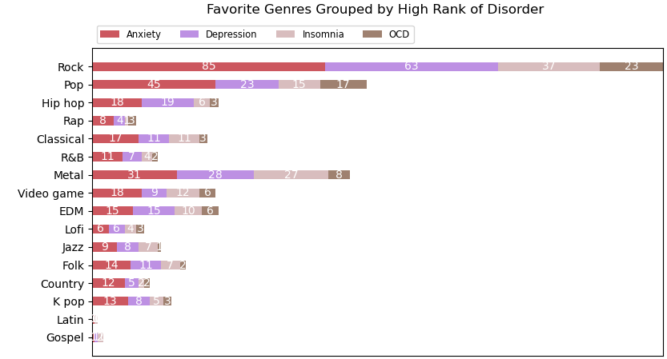
Does the frequency of listening to different genres correlate with different mental health disorders?
Actual frequency of listening
Favorite genres
Highest mental illness in listeners of Rock and Pop by frequency, but favorites are Rock, Pop, and Metal
Notes:
*** Sarah
Now let’s compare the genres most frequently listened to by those with high ranks of each disorder with the genres those same users listed as their favorites.
The results are similar but actually vary quite a bit.
The top three favorite genres are Rock, Pop, and Metal.
Metal is actually listened to 61% as much as rock, which aligns with favoritism, but Metal is listened to 63% as much as Pop, even though it’s just under Pop in favoritism.
This could indicate that listeners of Metal are more likely to report having worse mental health, though we don’t have enough information here to determine if listening to Metal music causes poor mental health.

Slide 10
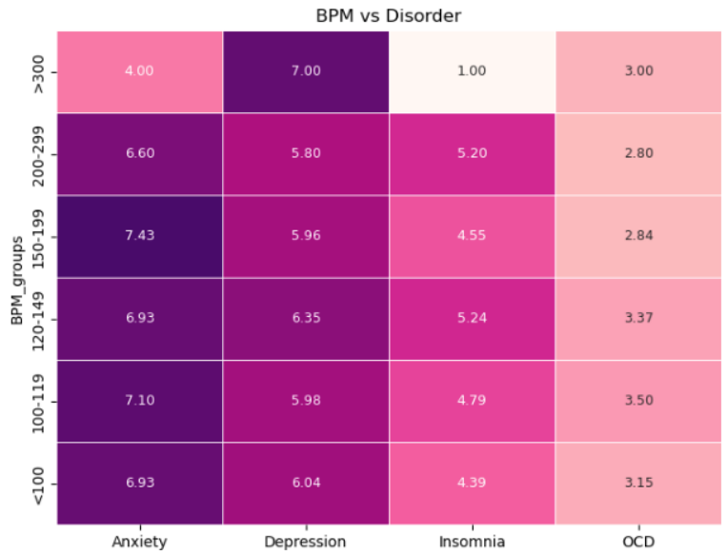

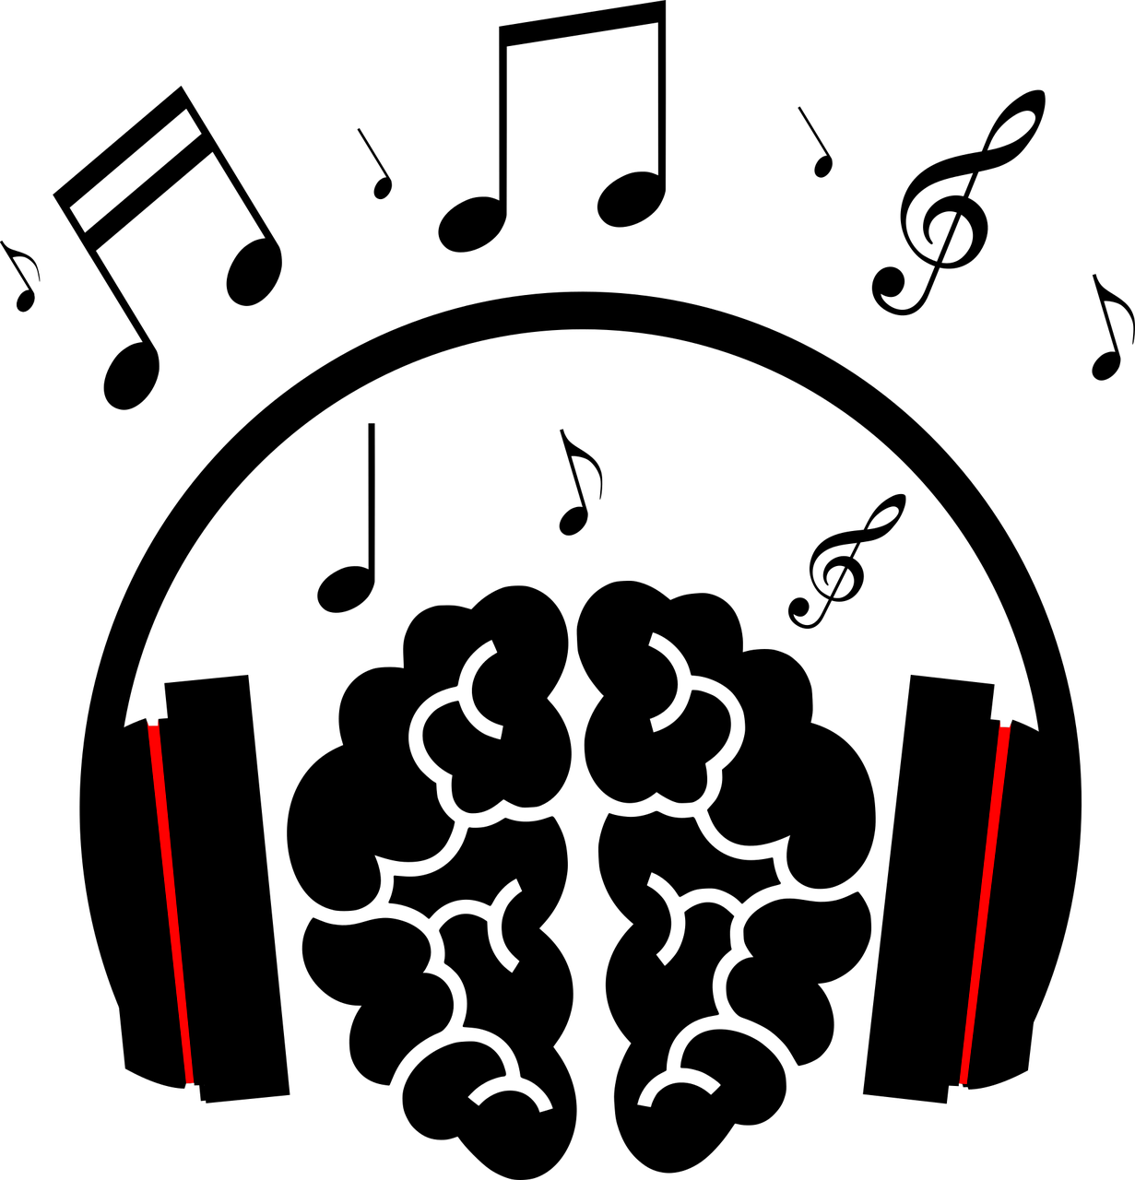
Can we use BPM to explain the most common genres’ relation to disorder status?
Means of most common BPM/user vs Disorder rank
Notes:
*** Sarah
You might think that if the top favorite genres for respondents with high mental disorder rank are Rock, Pop, and Metal, then there could be a relationship with high BPM and disorder rank.
On this heatmap, disorder rank is indicated by the color bar. You can see that disorder rank was similar for almost all users within each individual disorder, despite average BPM.
Since increasing the average BPM does not necessarily increase the disorder rank, we cannot say that BPM really makes much difference to disorder rank.
We can glean more information from looking at the favorite genres and frequencies of listening for each when predicting mental health status.

Slide 11
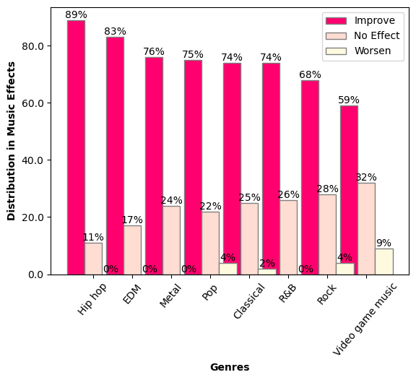
Which genres are most beneficial or detrimental to mental health status?
Music effects vs favorite genre
Genres with the most positive results:
Hip hop, EDM
Tend to be more upbeat
There is much variability in instrumentation and production type, so the results are subjective
The data was filtered by the genres with more interaction
Notes:
*** Gabriela
After analyzing the BPM and the frequency of the different genres, we wanted to analyze how the listeners perceived these genres' effects on their mental health.
* read the question*
For this visualization, we used the results for improvement, no effect, and worsened.
Also, because we wanted to ensure a more objective view of the results, we filtered the data by genres that received at least 26 votes on improvement.
This allowed us to focus on the genres that had a significant impact, such as Hip-Hop, EDM, and Rock, and drop the ones with lower interaction.
We have our top 3, with 89% percent of the listeners who chose hip hop as their favorite genre perceiving an improvement in their mental health, and only 11% assumed there was no effect.
On the other hand, Even though Rock got the highest ranking for improvement, it also got many votes for no effect. And that’s why is not in the top 3.

Slide 12
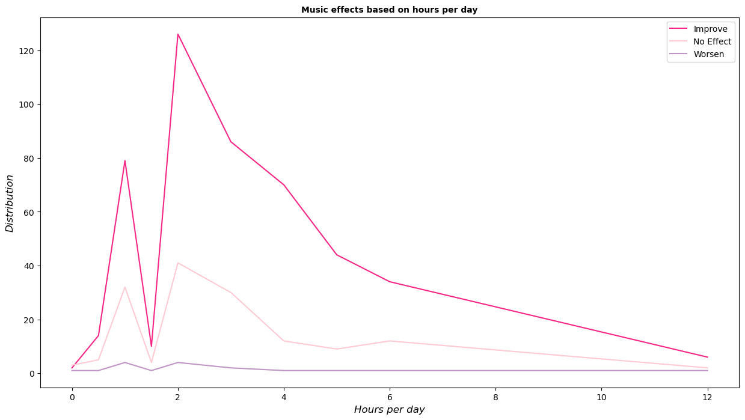
Music effects based on Hours per day
The average is 3.5 hours per day
Users who would spend 2-3 hours/day listening to music registered the highest rate of improvement.
Over 6 hours: no correlation with improvement in mental health
Notes:
*** Gabriela
CONTINUING WITH THE ANALYSIS OF THE HOURS PER DAY, we wanted to determine whether there was any correlation between the time spent listening to music per day and its impact.
Opposite to our hypothesis, fewer hours spent gets the highest results for improvement
The highest improvement was registered by users who would spend 2-3 hours/day listening to music.
Above 6 hours, there is not an evident correlation between the effects and the hours per day.
As we can see on the graph, these results have no significant outliers.

Slide 13
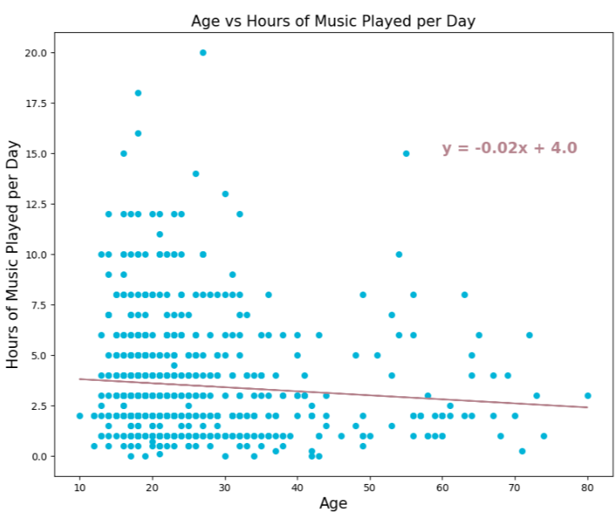
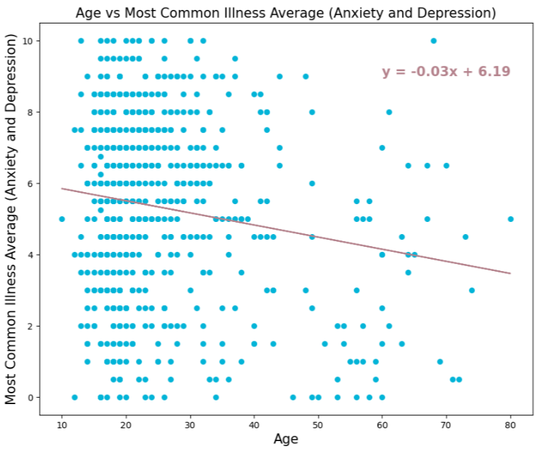
Regressions
R-value: -0.09. Weak regression
R-value: -0.16. Stronger negative correlation
Notes:
*** Elizabeth
Weak correlations with most of this data because all the results are subjective.
The first regression is very weak, which means there is no correlation between age and how many hours per day we listen to music.
On the 2nd graph we can see a stronger negative correlation because as we saw at the start of the presentation, rates of Anxiety and Depression decrease as we get older.

Slide 14
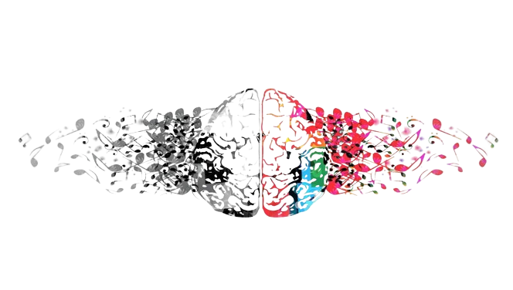
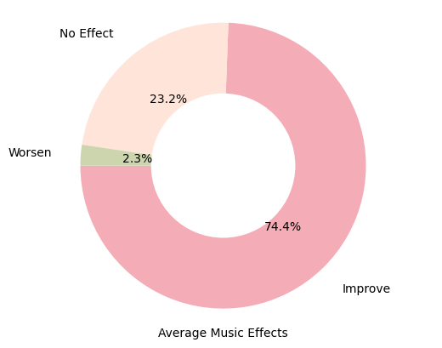
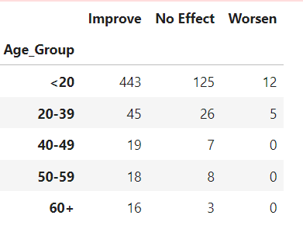
Conclusion
Listening to music is likely to improve mental health
Highest improvement with Hip hop, EDM, Metal, Pop, and Classical
Listen for 2-3 hours/day
Notes:
*** Gabriela
After different visualizations and analyses, we could conclude that listening to music is likely to improve mental health.
The most beneficial types of music we have are Hip-hop, EDM, Metal, Pop, and Classical. These showed the higher rates of improvement.
The best time we conclude to listen to music per day is 2-3 hours.
On the other hand, as the leaderboard on the screen shows, most people 20 years old and younger noticed an improvement in their mental health. HOWEVER, those are unreliable results due to how the information was collected. That mostly was online, but well go more in-depth with that on our limitations

Slide 15
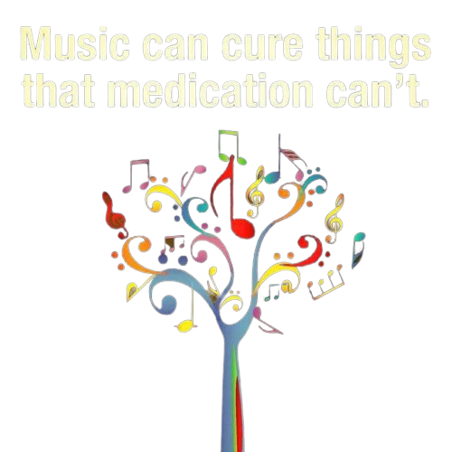
Limitations Future Study
1x survey; no trends over time
Subjective data; no parameters on how to rank mental health. Hard to establish relationships
Data largely came from the internet
Source of BPM: Most common? Highest?
This section was optional
Music effects
Improvement based on certain genres? Hours listened?
Which disorder(s) improved?
Concentrate results to a specific geographic location
Compare to actual mental health stats for objective data
Occupation of survey respondent
Influence hour listened/day
Listened during work or otherwise
Include gender of respondent
More to compare
Notes:
*** Sarah
We definitely have some limitations and suggestions for improvements for future study.
We can’t judge MH improvement with listening to music over time from this data. The same users reporting in over a set time period would offer more capability of establishing relationships with both frequency of genre usage and hours listened/day.
The MH data was very subjective. Users were allowed to choose their rank for each disorder from 0 to 10, so it follows that each user might interpolate their numbers differently. If these results were concentrated over a specific geographic location, for instance, the US, we could compare their music stats from the survey with actual published MH stats for objective data.
The BPM section was not specific at all. It was optional, so about 100 users did not give a number, and we don’t know if each user interpreted this number to be an average, the most common, or the highest BPM they listen to. This is probably why we couldn’t correlate anything with BPM.
The original data asked if users listened during work or not, but didn’t ask for occupation or when else they listen. Clarifying this might make that part of the data mean something. We would also like to see gender included as we have some hypotheses about how music effects men and women differently.
Lastly, we have no basis for the result in the Music Effects column. Was the effect from listening to certain genres or listening for so long? Many of our respondents listed high ranks for multiple disorders, so which one(s) does the effect apply to?
If we ran this survey in the future, we would clarify the questions to cover these limitations and hopefully glean more objective data.

Slide 16
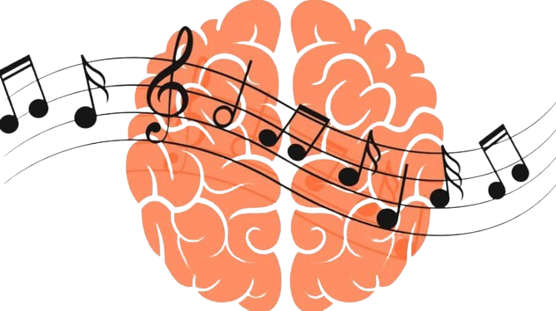
Works Cited
Kaggle dataset: Music & Mental Health Survey Results (kaggle.com)
Thank you Professor Booth for helping us find this!
Obsessive-Compulsive Disorder (OCD) - Psychiatric Disorders - Merck Manual Professional Edition (merckmanuals.com)
Basic information regarding different music genres and mental health disorders: Wikipedia.com
Data Analysis:
Matplotlib.org documentation
Xpert learning AI
TA Mike Wenner: troubleshooting ☺
Formatting:
Coolors.co
https://www.remove.bg/upload
Notes:
*** Sarah
- These are our sources. Thank you for listening!

